Slide 1
NUTRITION agent
IBM AICTE PROJECT
Presented By
Student name : AMJATH HUSSAIN S
College Name & Department : K. RAMAKRISHNAN COLLEGE OF ENGINEERING & Department of B.tech (AI&DS)

Slide 2
OUTLINE
Problem Statement
Technology used
Wow factor
End users
Result
Conclusion
Git-hub Link
Future scope
IBM Certifications

Slide 3
Problem Statement
People often face challenges in managing their nutrition due to lack of personalized guidance, awareness of dietary needs, and time to consult professionals. Existing tools provide generic meal plans and overlook individual factors like health conditions, fitness goals, cultural preferences, and allergies. This makes it difficult for users to make informed, sustainable food choices.
Proposed Solution: An AI-powered Nutrition Agent that uses Natural Language Processing (NLP), image understanding, and Retrieval-Augmented Generation (RAG) to deliver personalized meal plans, explain nutritional choices, recommend smart food swaps, and adapt to evolving health data making healthy eating accessible, tailored, and sustainable for everyone.

Slide 4
Technology used
IBM cloud lite services
Natural Language Processing (NLP)
Retrieval Augmented Generation (RAG)
IBM Granite model

Slide 5
IBM cloud services used
IBM Cloud Watsonx AI Studio
IBM Cloud Watsonx AI runtime
IBM Cloud Agent Lab
IBM Granite foundation model

Slide 6
Wow factors
This agent will revolutionize personal nutrition management by delivering expert-level guidance instantly, helping users make smarter food choices, improve long-term health, and build sustainable habits. It empowers users with contextual, culturally aware advice tailored to their evolving needs—all without needing constant dietician visits.
Unique features:
Multimodal input: Understands food photos, grocery labels, and text
Personalized meal plans based on health conditions, fitness goals & preferences
Smart food swaps & nutrition explanations (e.g., “Why is this better?”)
Real-time adaptability based on user feedback & changing health metrics
Allergy & cultural dietary filter integration
Nutrition education through conversational learning
Integration with wearable health data for dynamic recommendations

Slide 7
End users
Health-conscious individuals
Hospitals, clinics, and wellness centers
Parents managing child nutrition
Elderly care facilities
Public health organizations and NGOs

Slide 8
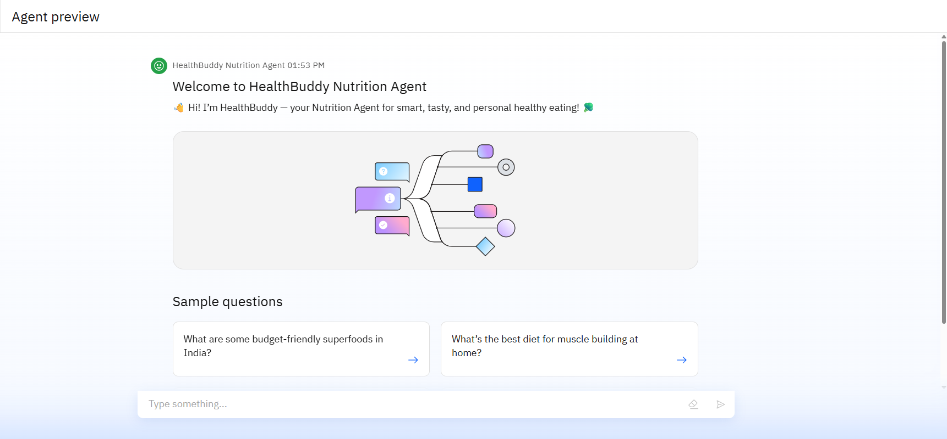
Results
This is the preview screen of your HealthBuddy Nutrition Agent chatbot. It welcomes users with a friendly intro:
"Hi! I’m HealthBuddy — your Nutrition Agent for smart, tasty, and personal healthy eating!"
The interface includes:
A central visual showing a branching flow, representing interactive AI conversations.
Sample questions like “What are some budget-friendly superfoods in India?” and “What’s the best diet for muscle building at home?” to guide users.

Slide 9
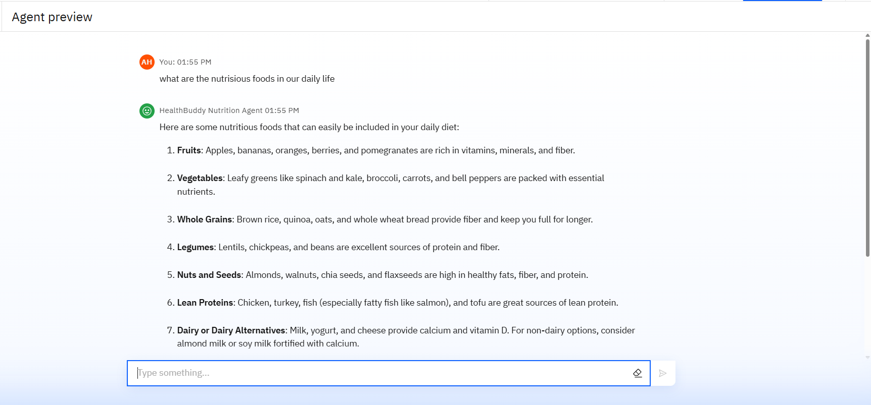
Results
User Query Display: Shows the user's question ("what are the nutritious foods in our daily life") with timestamp.
Structured AI Response: The AI replies with a numbered list of 7 nutritious food categories, each explained clearly.
Health Focus: Highlights benefits like vitamins, fiber, protein, and healthy fats.
User-Friendly Interface: Clean design with visible chat history and response formatting.
Input Box: Allows users to continue asking questions interactively.

Slide 10
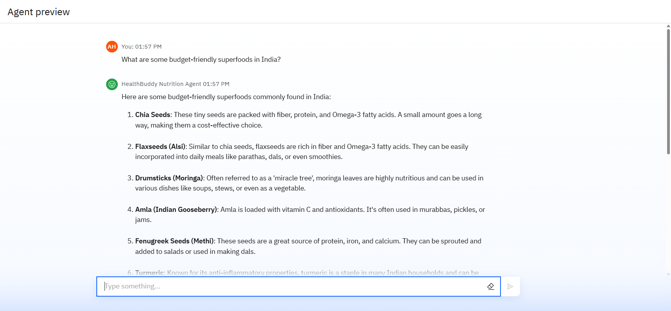
Results
Interactive Nutrition Agent: Responds to user queries in real-time with expert-backed answers.
Culturally Relevant Recommendations: Suggests superfoods commonly found and used in Indian households.
Budget-Friendly Focus: Emphasizes affordability while maintaining nutritional value.
Easy-to-Read Format: Uses numbered lists with bold headings and short explanations for clarity.
Practical Usage Tips: Suggests simple ways to include each superfood in daily meals.

Slide 11
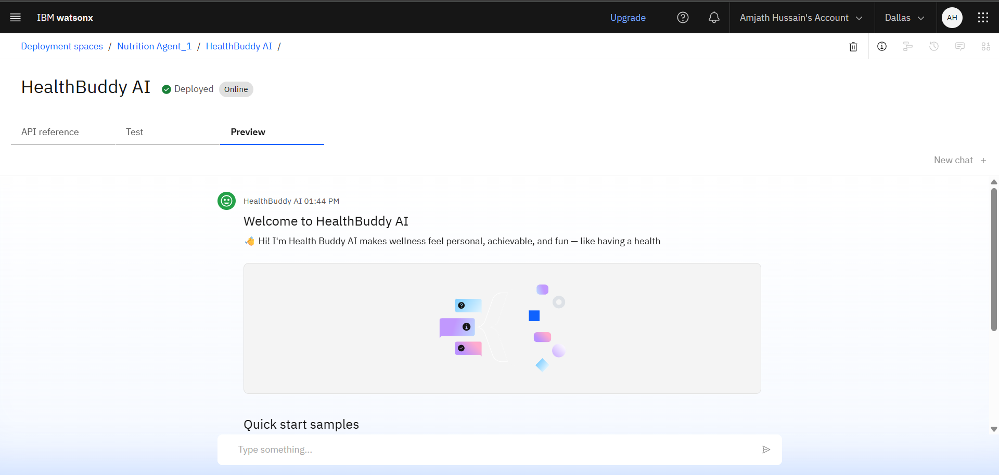
Results
Deployed AI Agent

Slide 12
Conclusion
The Nutrition Agent delivers smart, personalized meal planning and guidance tailored to health goals and lifestyle.
It saves time by automating diet tracking, nutritional analysis, and food recommendations.
This AI-powered assistant enhances healthy living by making expert nutrition support accessible, consistent, and scalable across individuals and institutions.
Most importantly, this assistant helps bridge the gap between limited in-person consultations and generic diet tools.

Slide 13
GitHub Link
GitHub Link : https://github.com/amjathhussain31/IBM-Project

Slide 14
Future scope
Multilingual Research Support
Voice-Activated Research Assistant
Integration with Wearables and Health Apps
Cultural & Regional Food Adaptation
AI-Powered Grocery & Meal Planning Assistant
Nutrition Coaching with Real-Time Feedback

Slide 15
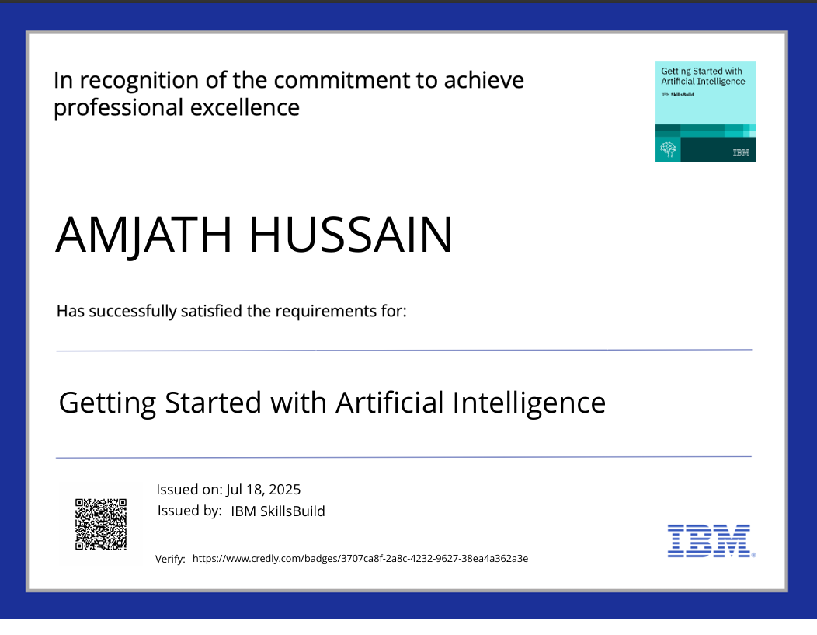
IBM Certifications

Slide 16
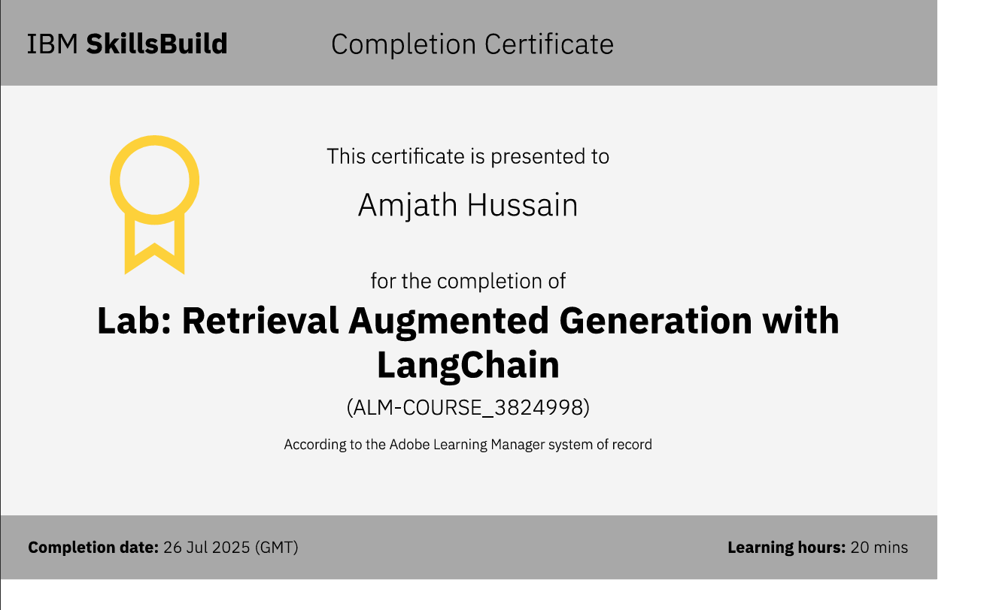

Slide 17
THANK YOU

